Slide 1
Genome Analyses Project
Paper 5- Scaffold 6
Jiarong Liang

Slide 2
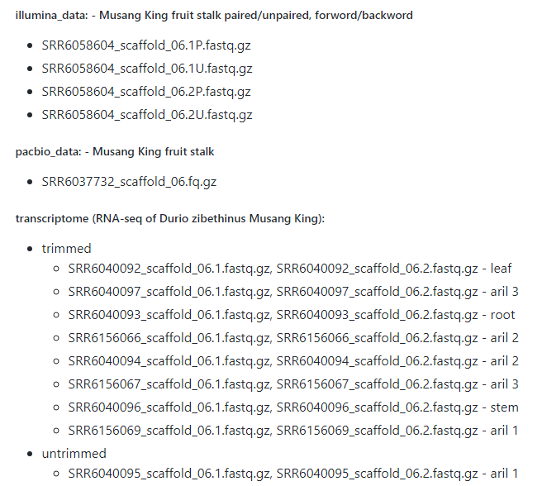
Data Used
DNA-Illumina
DNA-Pacbio
RNA-untrimmed (aril)
RNA-trimmed
(leaf aril root stem)

Slide 3
Workflow
Reads quality control
Genome Assembly
Transcriptome Assembly
Annotation
Statistical analyses

Slide 4
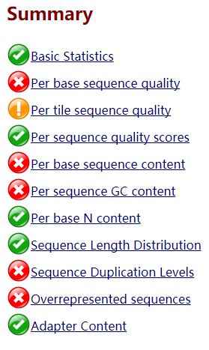
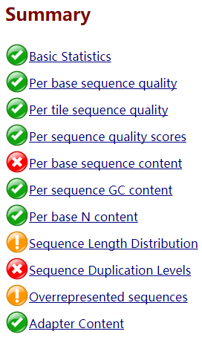
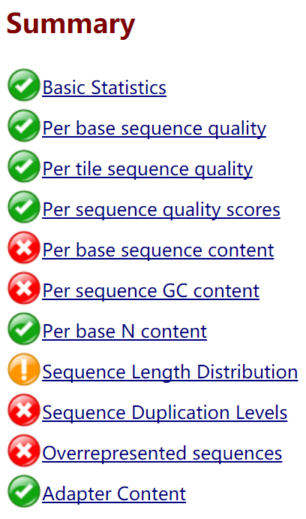
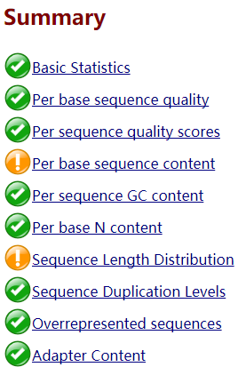
Result – Reads trimming and Quality check
Untrimmed
Provided Trimmed
My Trimmed
DNA’s Illumina

Slide 5
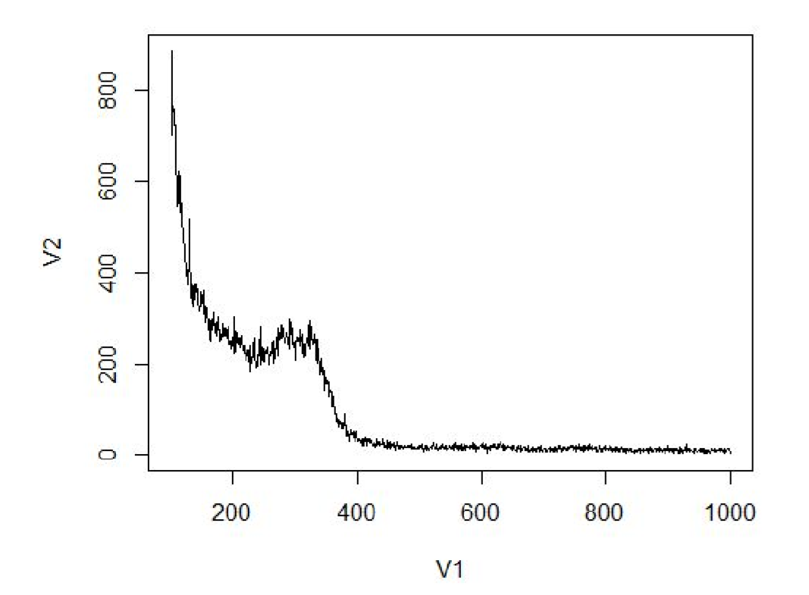
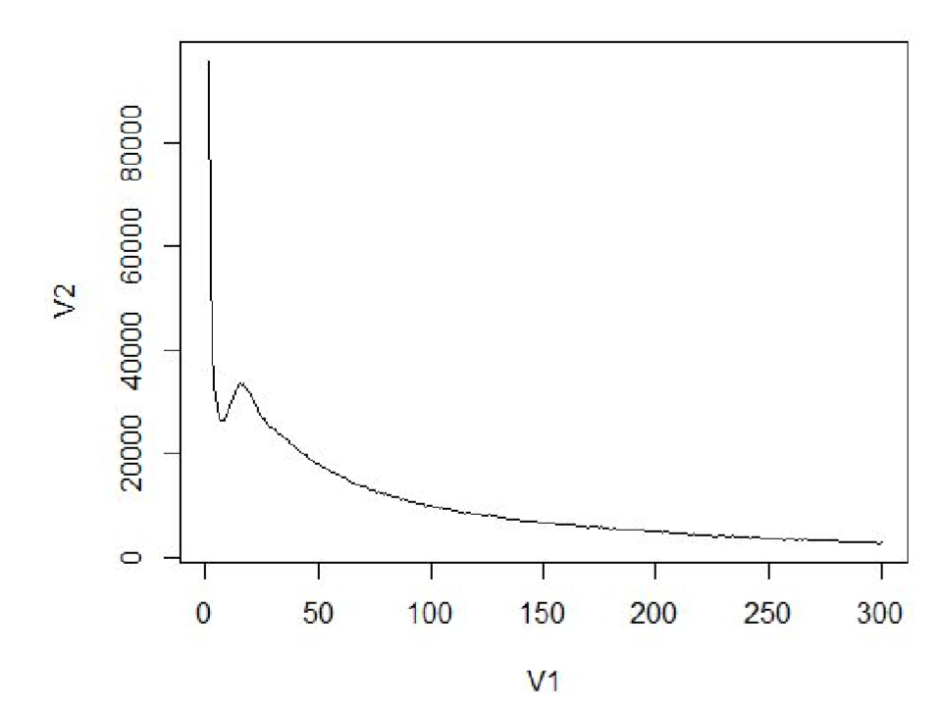
Result – K-mer NOT GOOD
K=31, Predict size: 0.3 M
Paper:27M
K=11, Predict size: 70.9 M

Slide 6
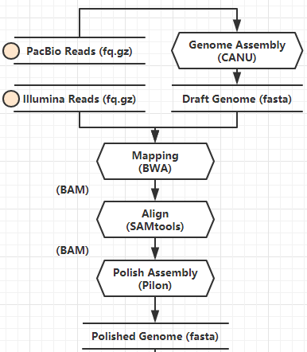
Result – Genome Assembly & Polish
CANU’s draft genome has 659 contigs, total length 35452764 bp
Pilon didn’t improve the assembly quality
97.40% reads mapped back to genome
Assembly file: a fasta file

Slide 7
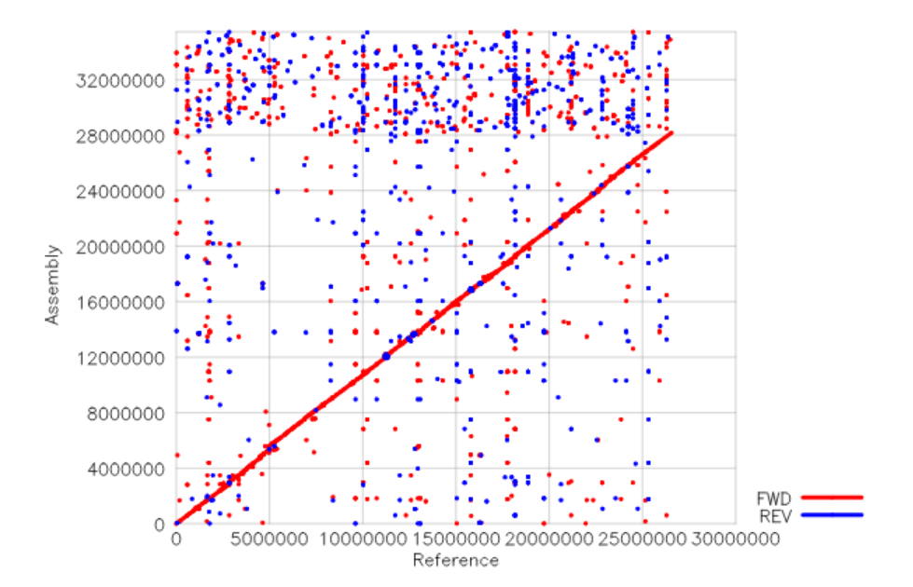
Result – Genome Assembly quality
Not good
QUAST

Slide 8
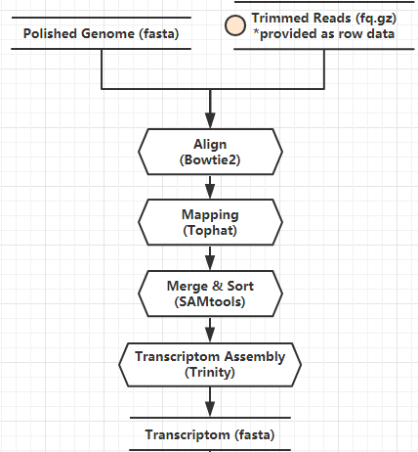
Result – Transcriptome Assembly
90%-95% reads mapped to genome’s assembly
Assembly file: a fasta file
N50: 3145
Fail to compare with paper

Slide 9
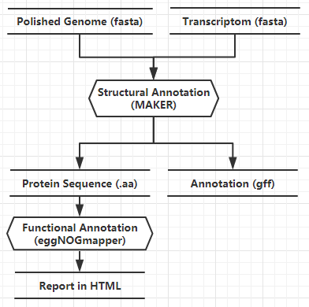
Result - Annotation
Fail to do training (snaphmm & AUGUSTUS)
Use tools to grep possible protein sequence from gff for functional annotation

Slide 10
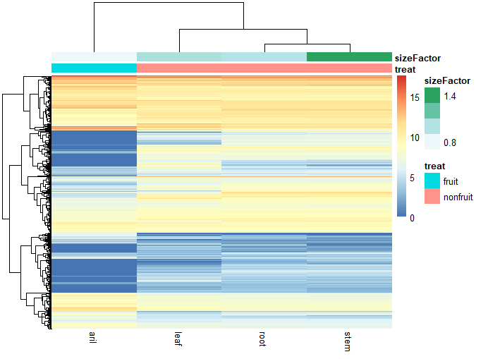
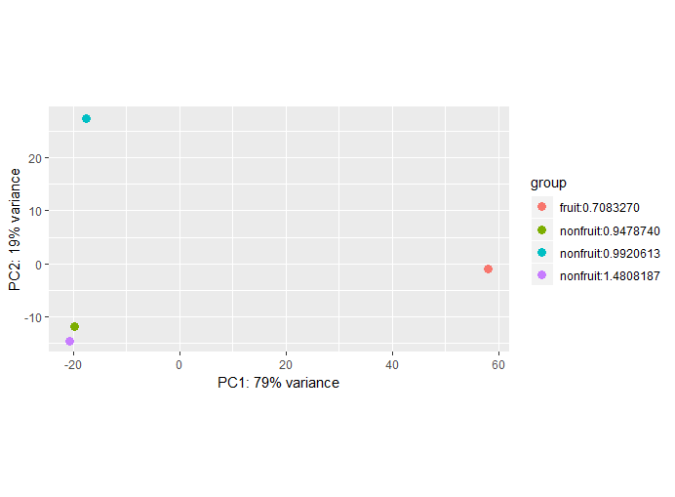
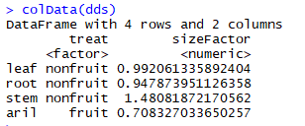
Result - Statistical analyses

Slide 11
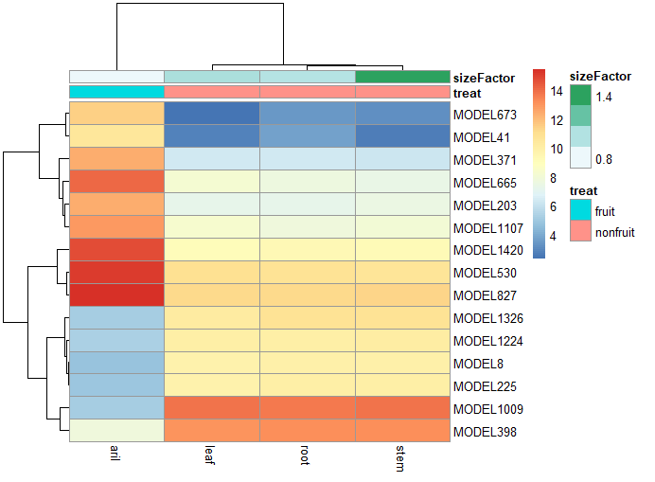
Result - Statistical analyses
673 |Plant invertase/pectin methylesterase inhibitor
41 |?
371 |no match
665 |cytochrome P450
203 |Nuclear pore complex protein
1107 |NAC domain-containing protein
1420 |glutamate--cysteine ligase
530 |no match
827 |Nucleoside diphosphate kinase
1326 |caffeic acid
1224 |no match
8 |disease resistance protein
225 |60S ribosomal protein
1009 |Abscisic acid 8'-hydroxylase
398 |jumonji domain protein
Protein to regulate gene expression &
Enzyme for metabolism

Slide 12
Result – Some Shared Expression
serine threonine-protein phosphatase
Vesicle-associated membrane family protein
RNA recognition motif. (a.k.a. RRM, RBD, or RNP domain)
Hydroxyproline-rich glycoprotein family protein
30S ribosomal protein
Cytochrome p450
Protein of unknown function (DUF1336)
heat shock protein
zinc finger protein
66 kDa stress
Conserved molecular structure/protein
Basic metabolic
Resistance of stress environment

Slide 13
Biological Interpretation
In fruit and non-fruit part of Durian:
Different gene expression ->
Different metabolic pathway ->
Different composition
Different function -> different gene
Metabolic rate -> expression level
Shared express: Majority, basic metabolic functions
!! It’s just a scaffold, and lots of errors in my result

Slide 14
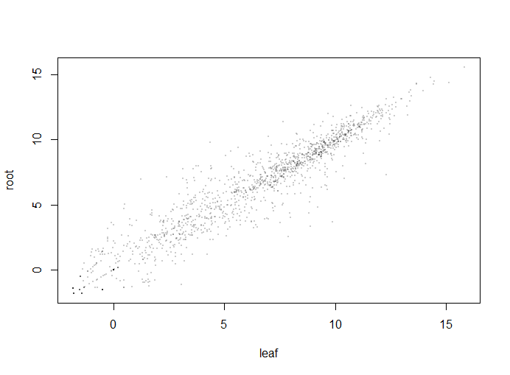
Poor quality Warning!
Assembly quality is poor, which could affect the following steps
Didn’t do training & didn’t use protein information in maker
Normalization when doing statistical analyses ok but not perfect

Slide 15
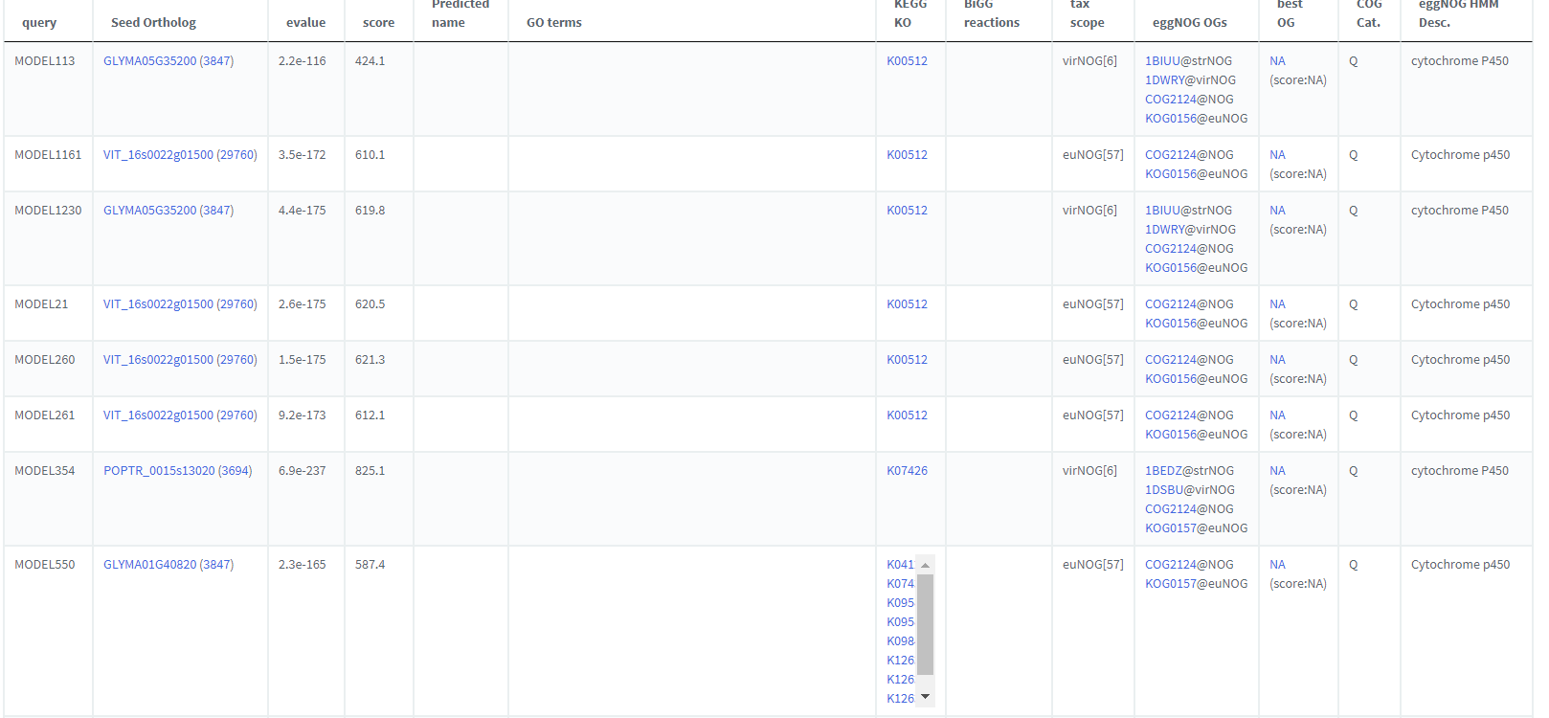
Hits of cytochrome P450 of different organisms
The same gene didn’t counted in together?
The expression of different enzyme in the family?

Slide 16
Thanks/Questions?

